Slide 1
CAS Project – GSD
Presented By:
Shri Hari Prasath M S (2318907)
Tamil Selvan S (2318960)
Ezhil Chandrasekar S (2318934)
Harish Natarajan T (2318912)

Slide 2
CONTENTS
Introduction
Requirements
Screenshots
Excel Outputs
TestNG Report
Extent Report

Slide 3
INTRODUCTION
Our project is to build the automation test for the GSD application in One-Cognizant webpage. We have developed this using Selenium with TestNG framework. We used selenium java for the automation purposes, we wrote script in java and integrated with frameworks like TestNG, Apache POI and Extent reports. As a team of four we have divided the modules among ourselves and completed the project successfully. With the help of mentors and coach we have clarified our doubts and completed the project.

Slide 4
REQUIREMENTS
Navigate to Be. Cognizant Website and capture the user information.
Click One Cognizant application.
Search GSD in One Cognizant and click on Live Support - GSD application from search results.
Validate the welcome message of GSD Application.
Validate the default country and language.
Get all the drop-down details from Language drop down.
Get all the details present in the GSD page with tooltips and by changing Location from drop down (for three random Locations).

Slide 5
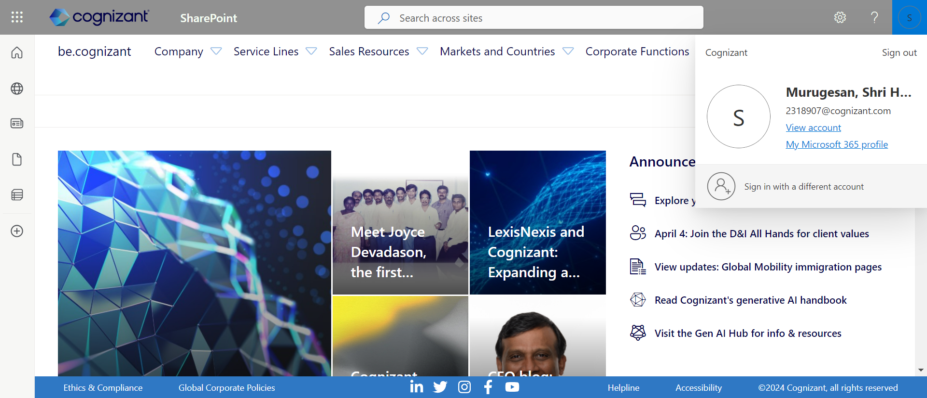
SCREENSHOTS
Test case – 1 (Validating user informations)

Slide 6
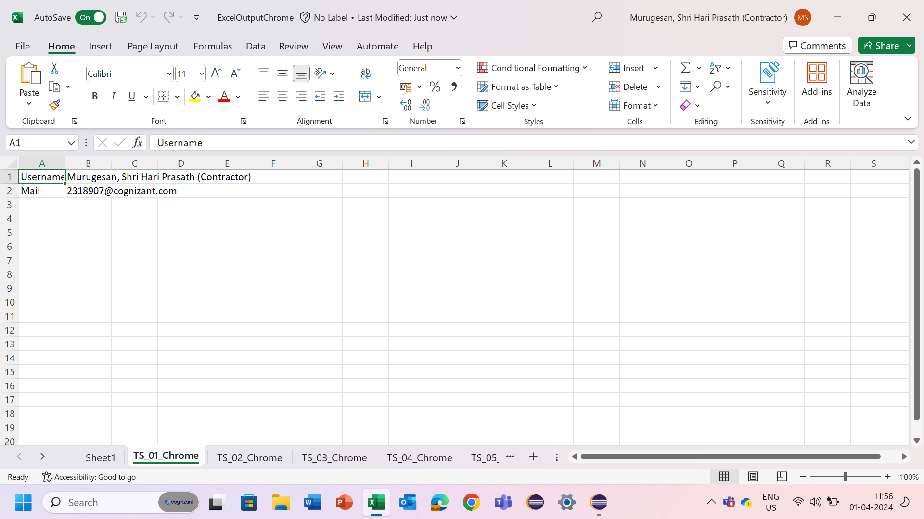
Excel output

Slide 7
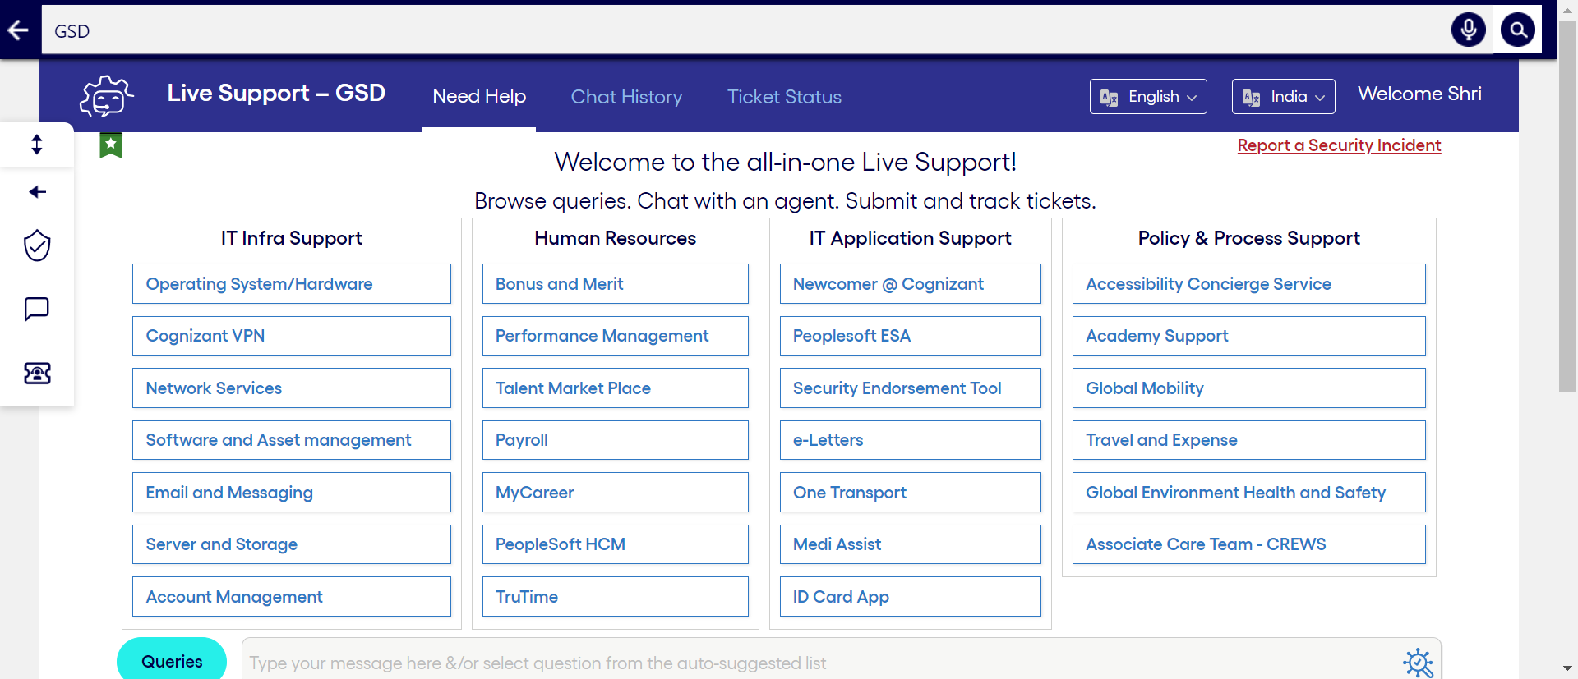
SCREENSHOTS
Test case –2(Validating Welcome message)

Slide 8
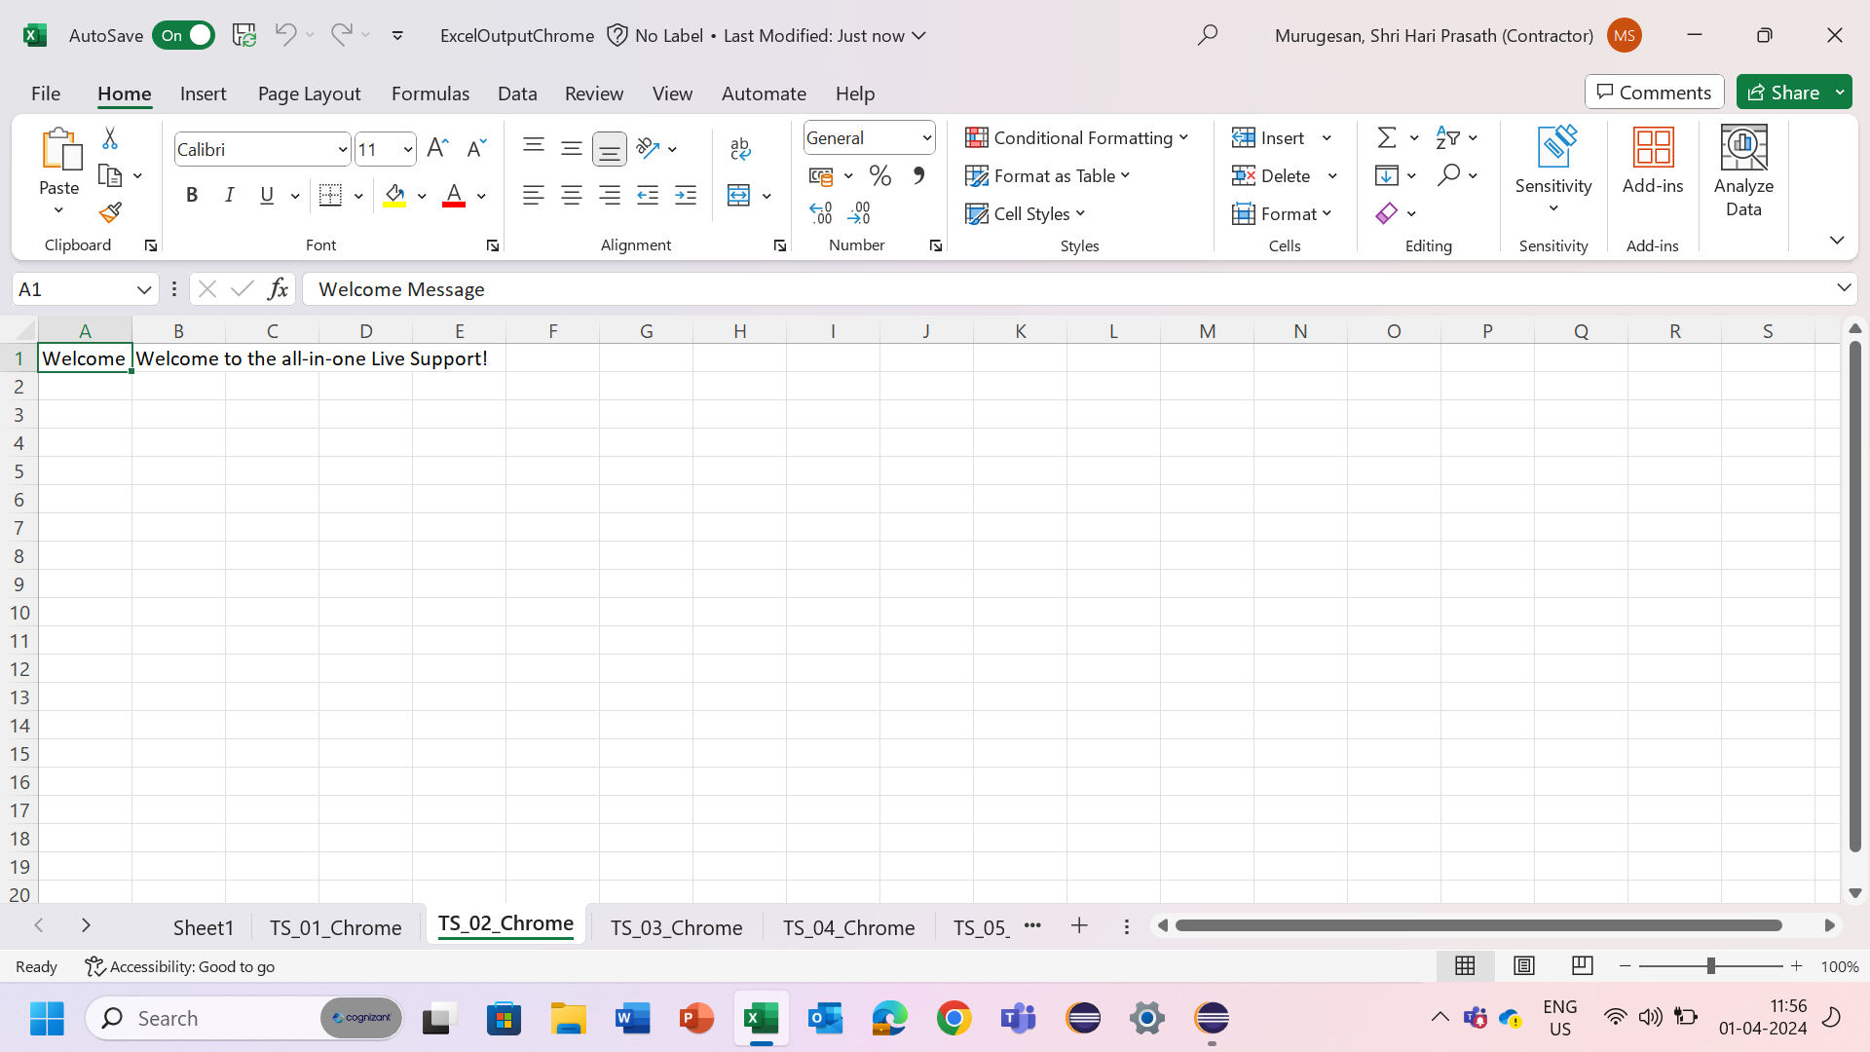
Excel output

Slide 9
SCREENSHOTS
Test case –3 (Validating default country and language)

Slide 10
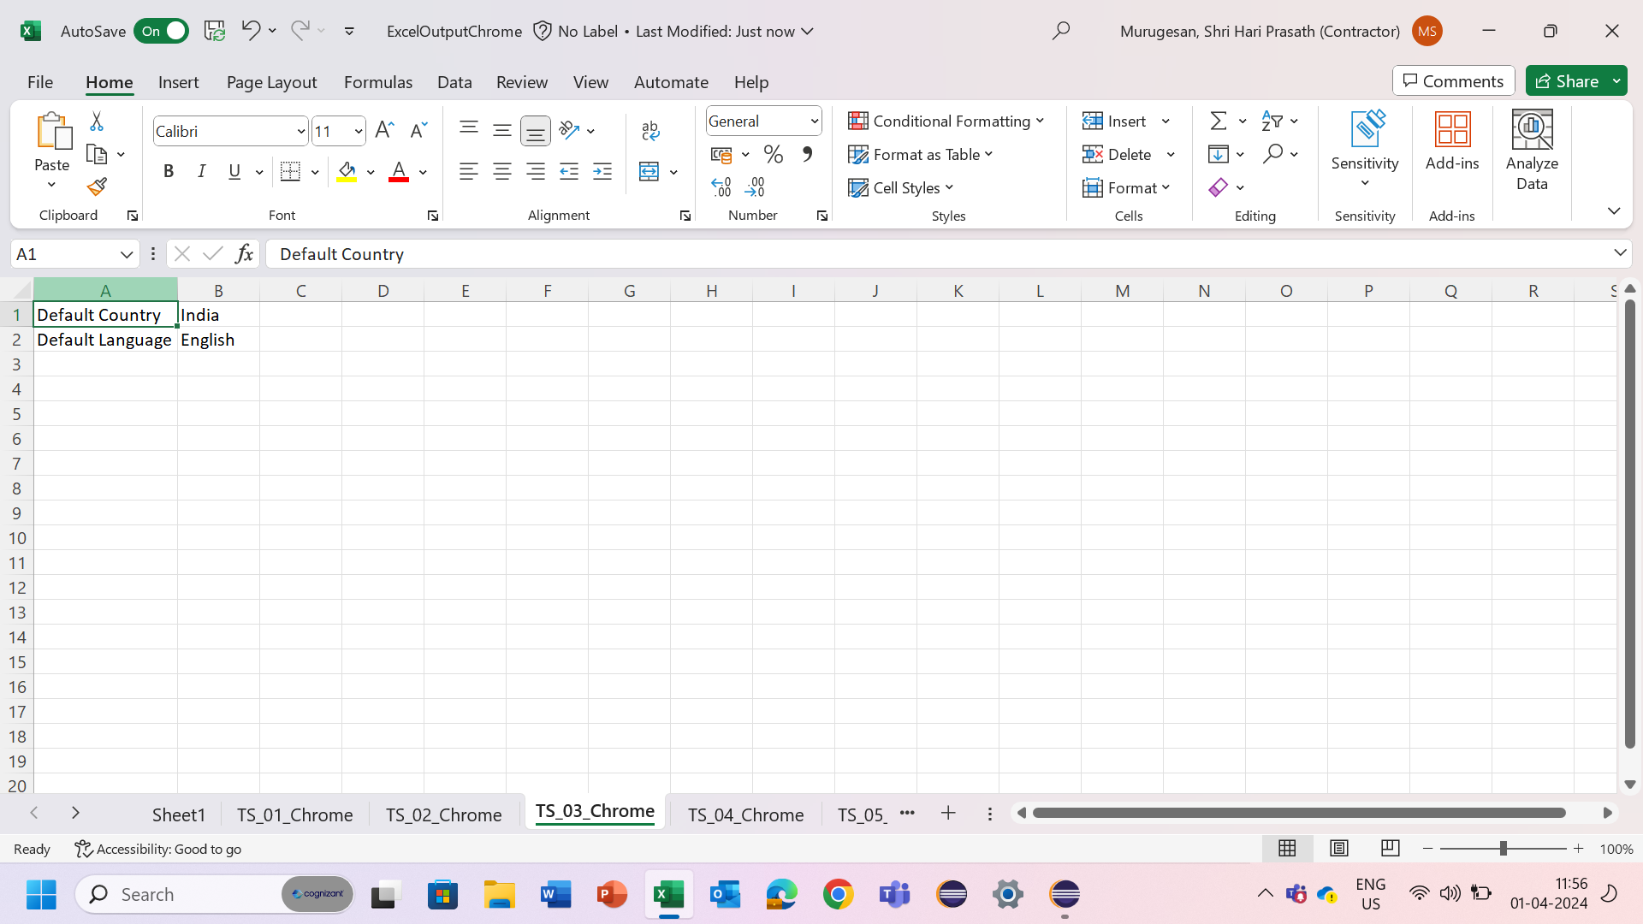
Excel output

Slide 11
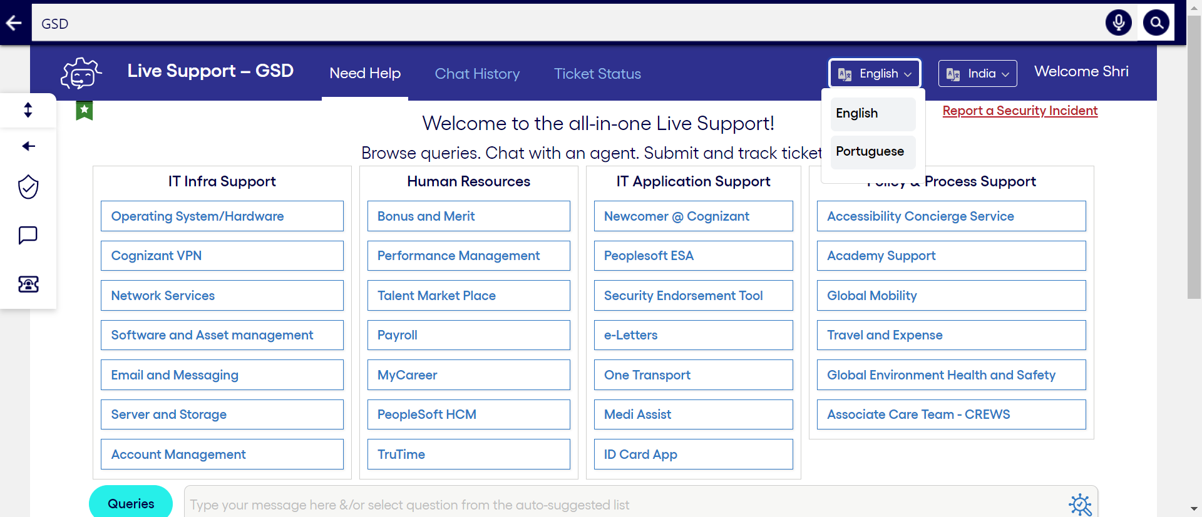
SCREENSHOTS
Test case – 4 (Getting available options in Language drop down)

Slide 12
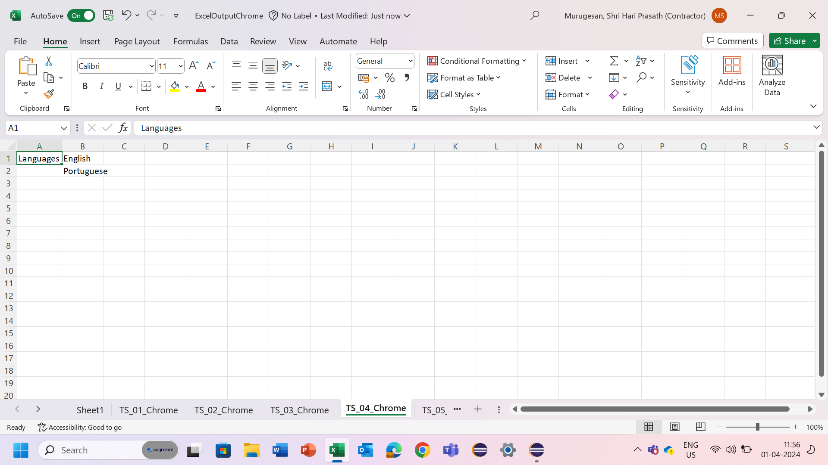
Excel output

Slide 13
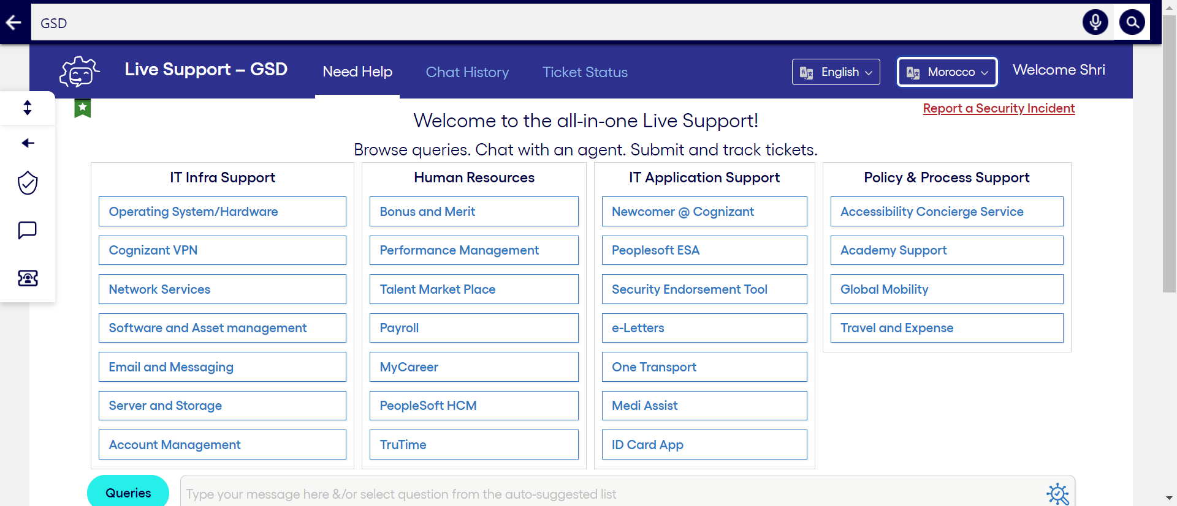

SCREENSHOTS
Test case – 5 (Getting details present in the GSD page)

Slide 14
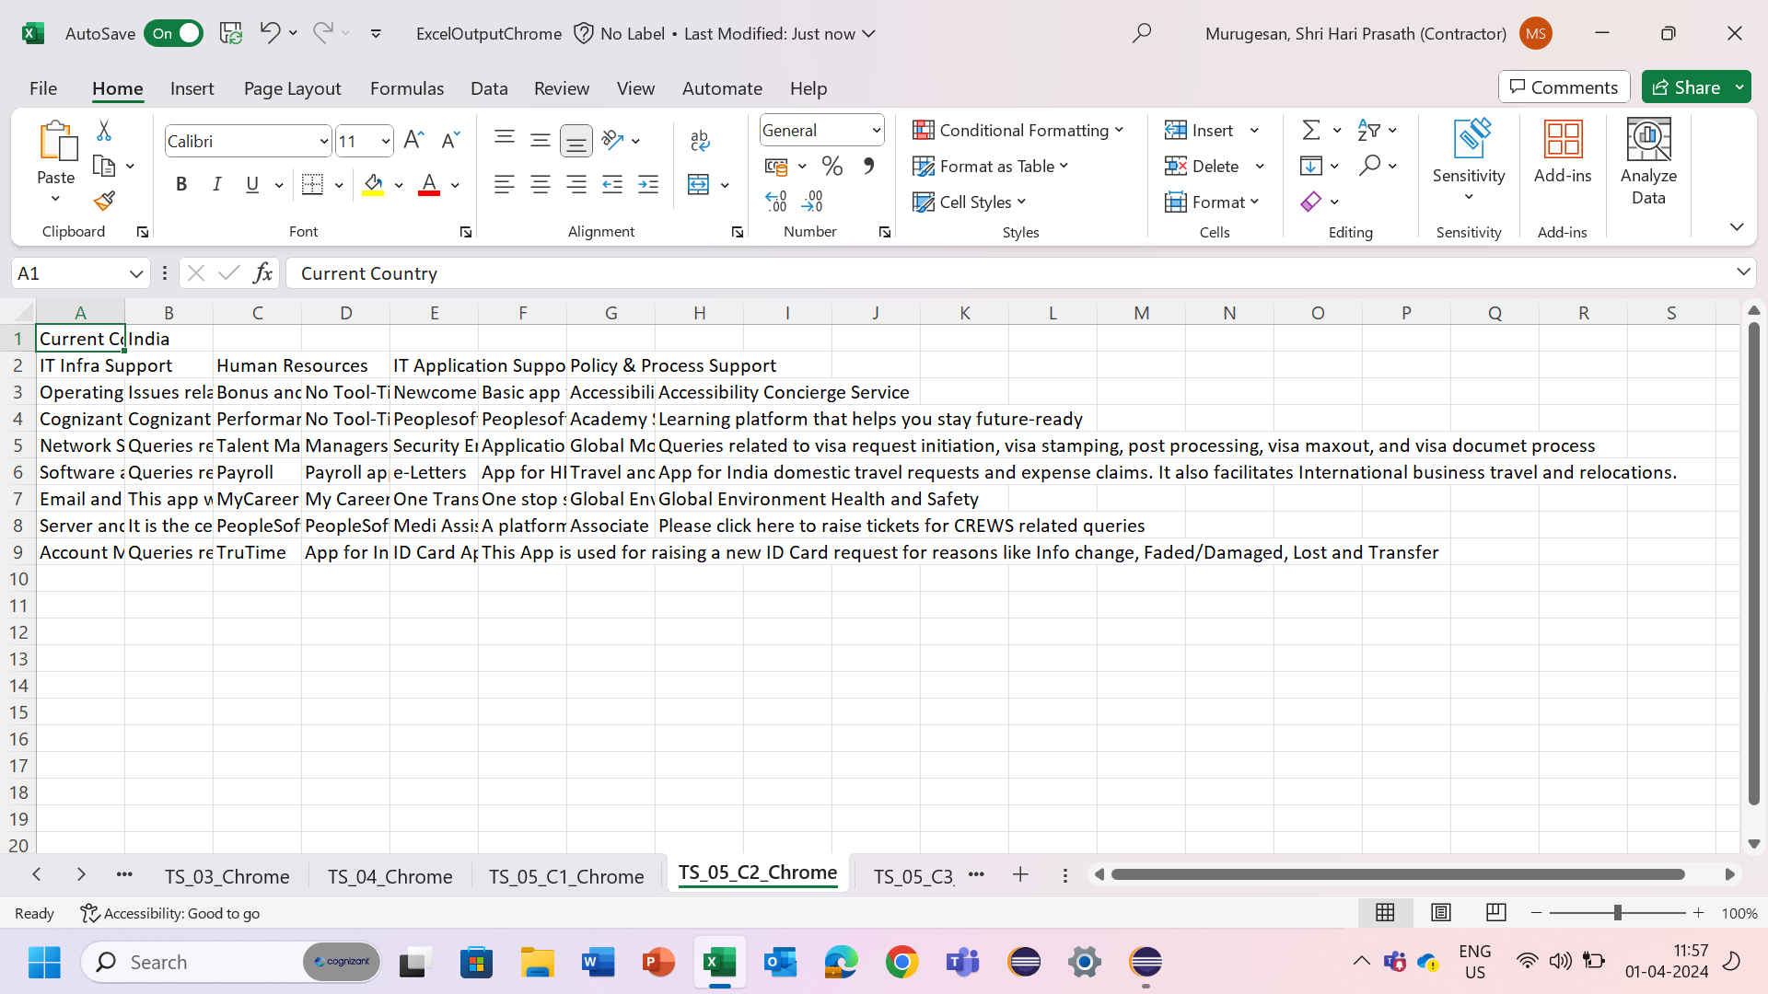
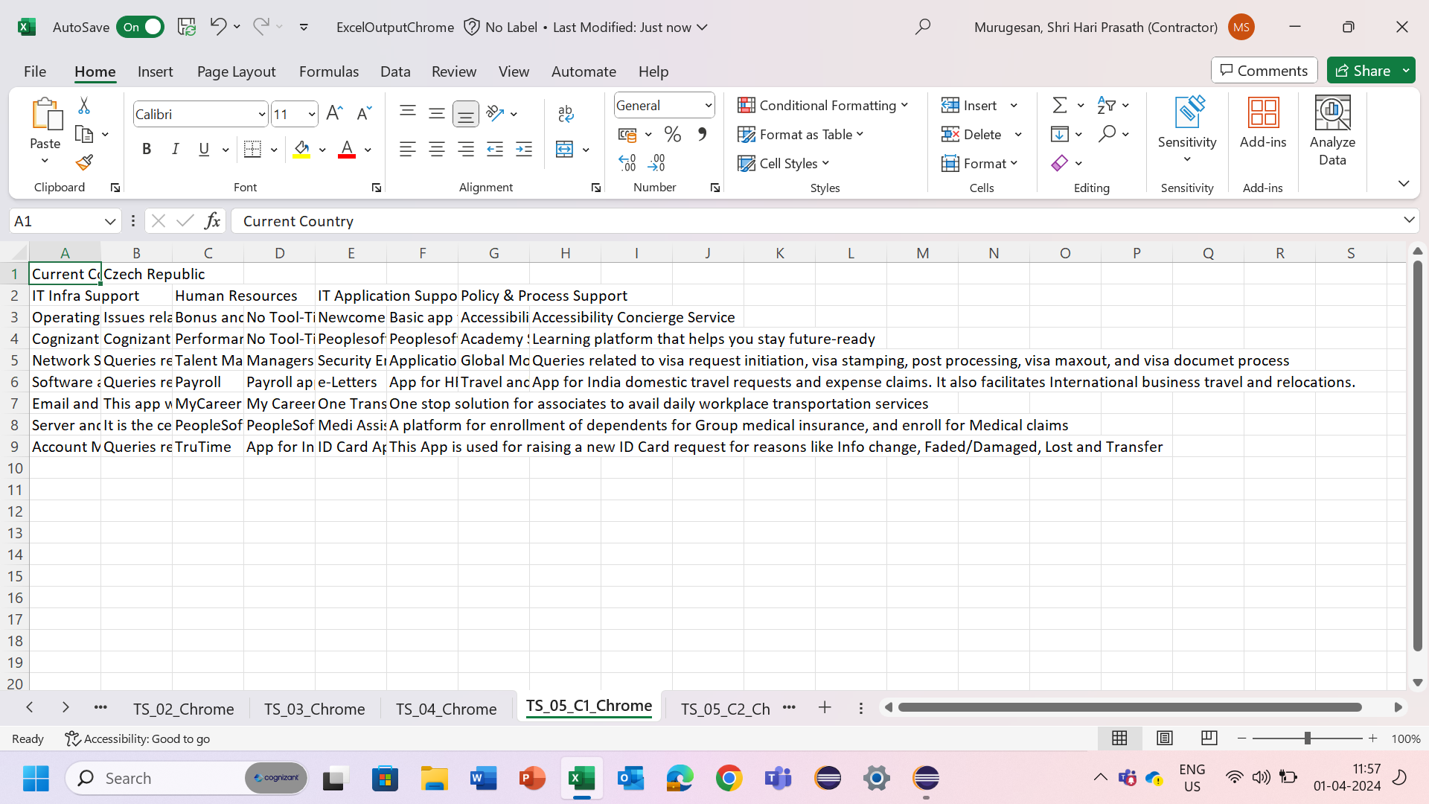
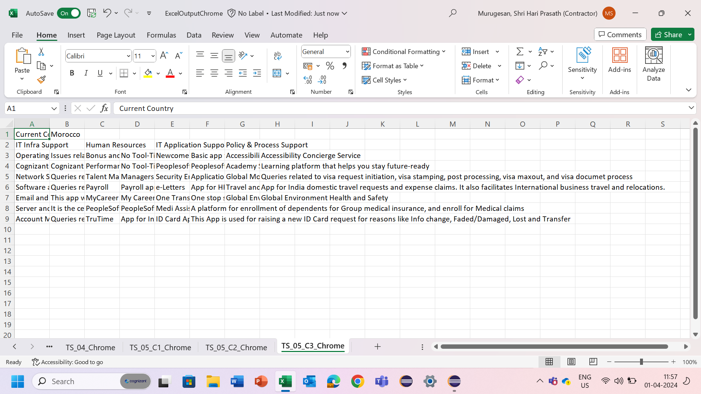
Excel output

Slide 15
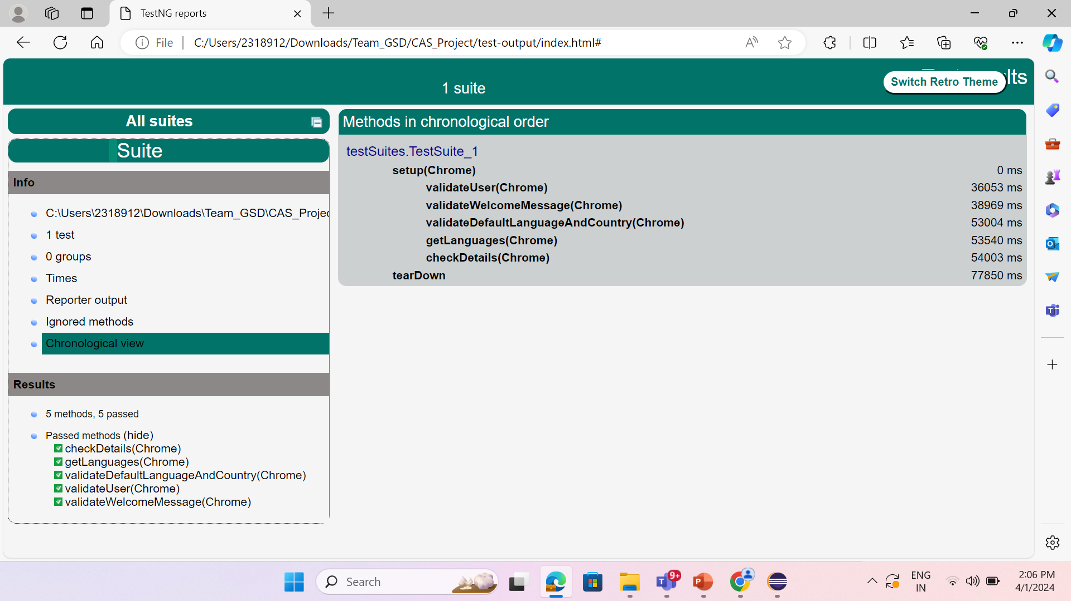
TestNG Report

Slide 16
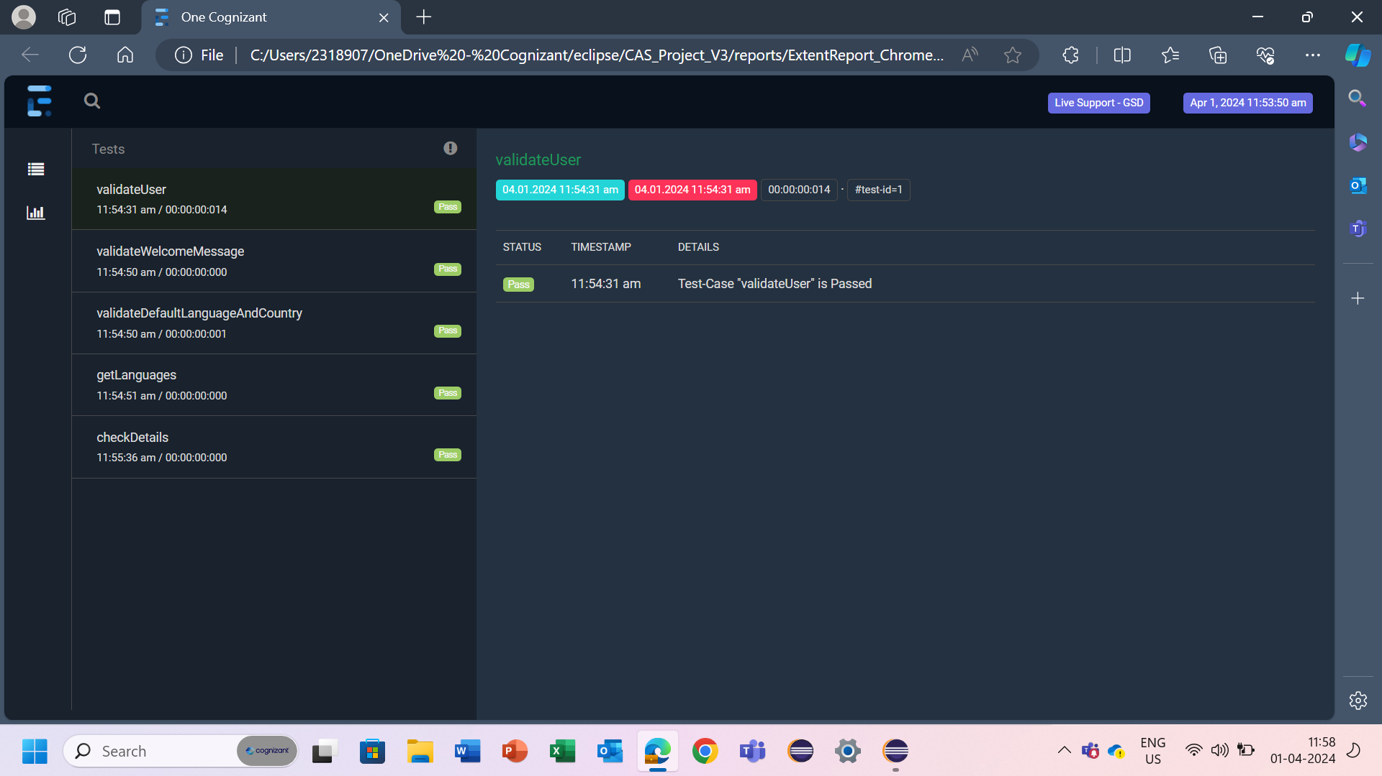
Extent Report

Slide 17
Thank you

